Slide 1
Cash Flow
by abdelrahman khaled

Slide 2
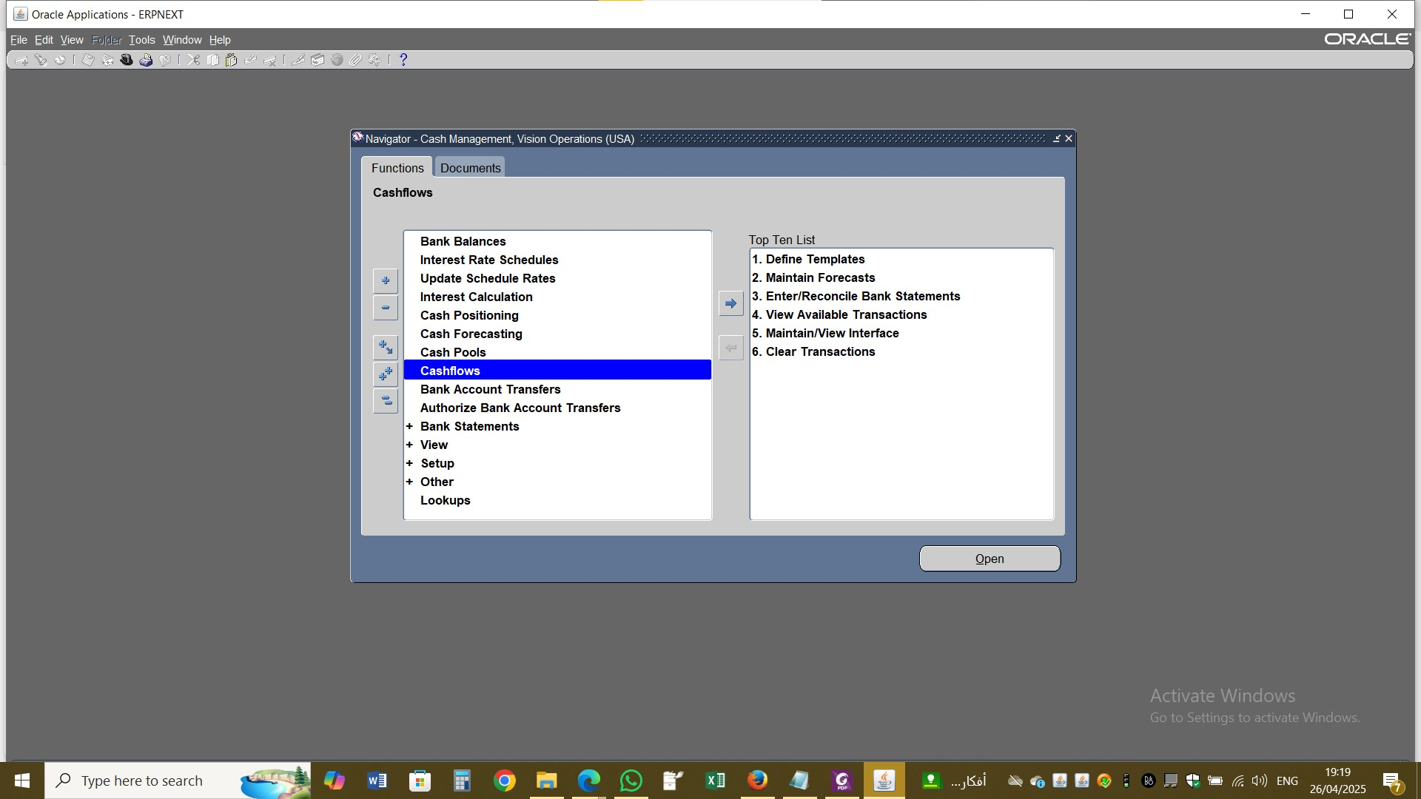

Slide 3
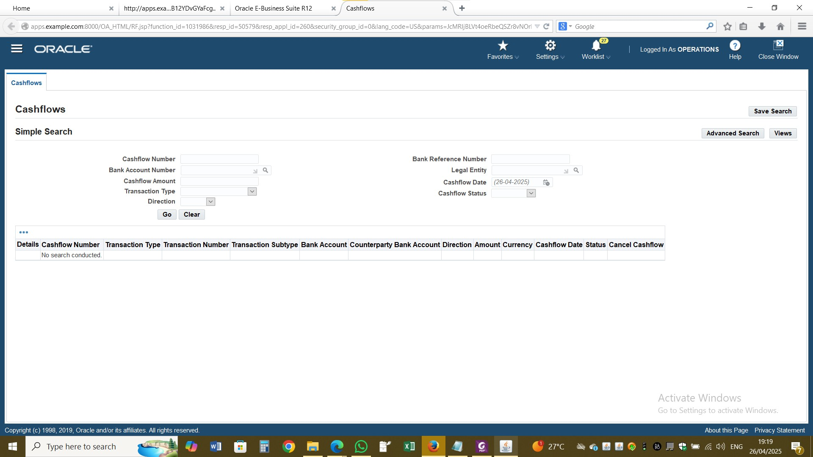

Slide 4
